Slide 1
Metasploit frame work
Name: Yasar Azimi
ID:#44158
Class: ITC 470
Type: Presentation
Teacher: Dr. Ala Abdulaziz
Date: 19/10/2023

Slide 2
Metasploit and the step needed for its use in windows OS
The Metasploit Framework is the most commonly-used framework for hackers worldwide.
1- Check the ip address for the OS using “netdiscover”.
2- Checking the IP/getting info on ports and Scripts using “Nmap”.
3- Check using the script for SMV-vulnerabilities for the IP/TCP/Active Port using “nmap-Script smb-vuln”.
4- opening metasploit frame work using “msfconsole”.
5- searching for the ms17-010 function.
6- Set the right host using the “set rhost ip address” and using exploit.
7- Results.

Slide 3
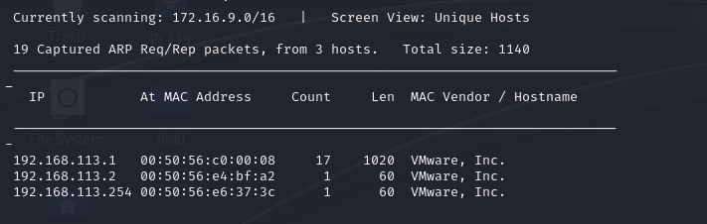
Step 1: Checking IP

Slide 4
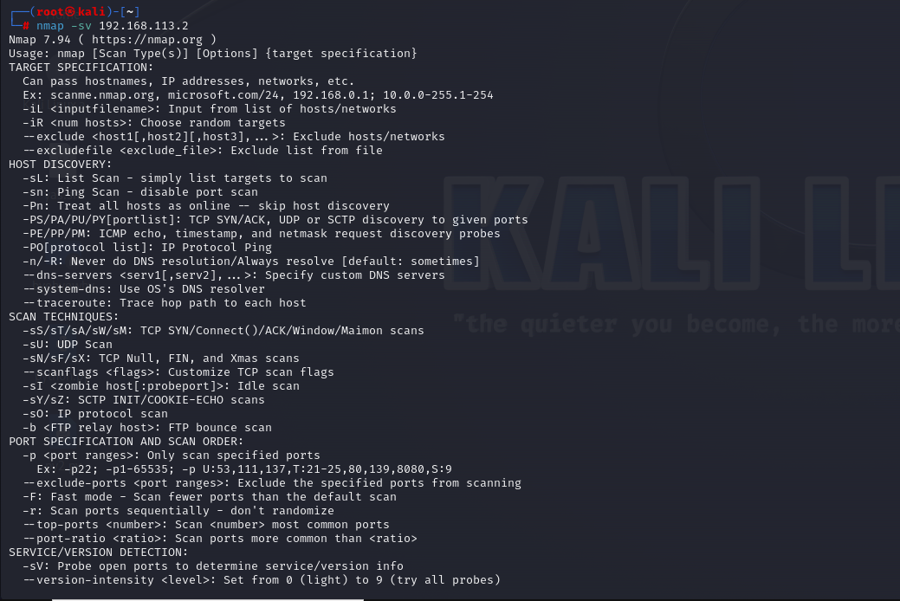
Step 2: Checking port/script/info nmap –sv IPAddress

Slide 5
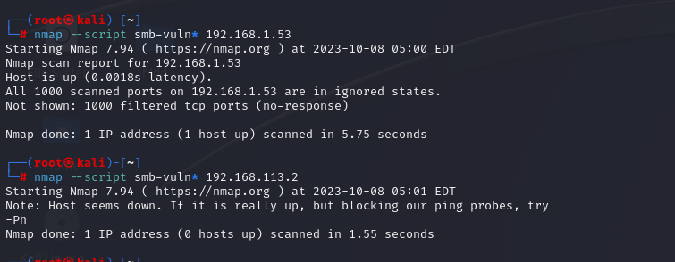
Step 3: Checking SMV-vulnerabilities for the IP/TCP/Active Port using “nmap--Script smb-vuln* IPAdress”.

Slide 6
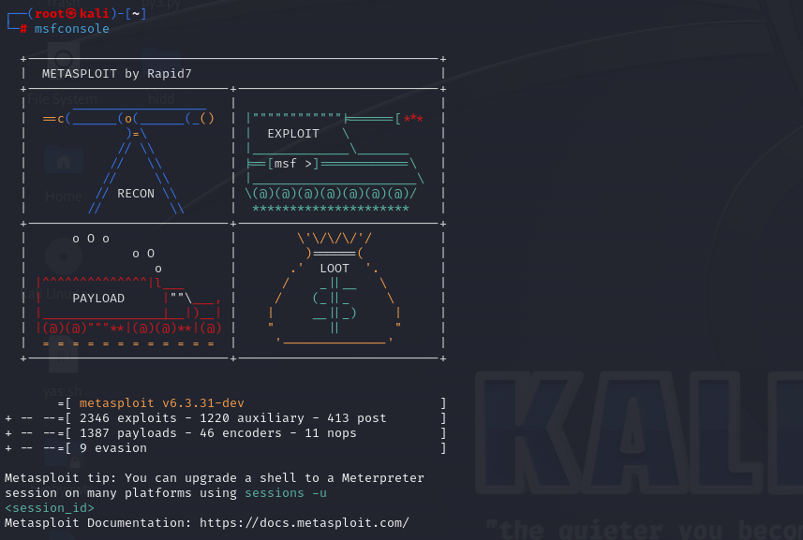
Step 4: Opening metasploit

Slide 7
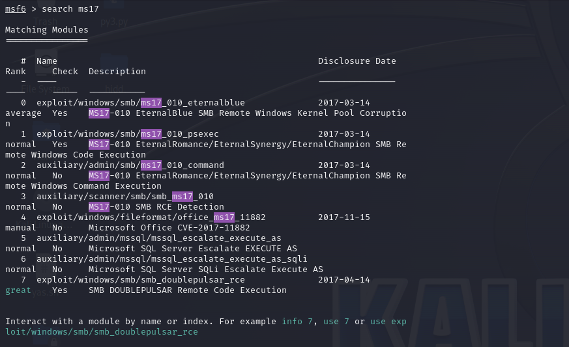
Step 5: searching for the ms17-010 function Used by agencies to gain access to the windows Os

Slide 8
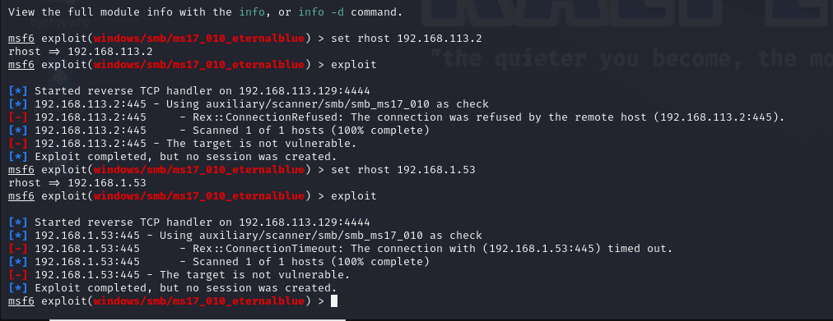
Step 6: Set the right host using the “set rhost ip address” and using exploit

Slide 9
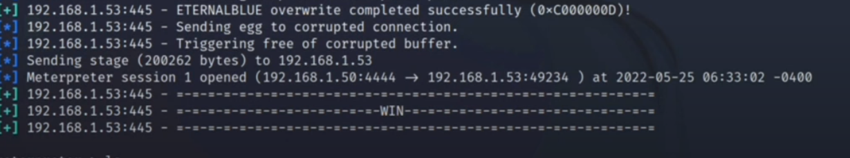
Step 7: Result

